Slide 1




Presentation
On
Heart Failure Prediction

Slide 2





Meet our team
Md Al-Amin
Sultana Marjan
Sourav Barman
ASH1925008M
BKH1925010M
ASH1925030M

Slide 3
Presented TO
Nazmun Nahar
Lecturer
IIT,NSTU

Slide 4



1
Introduction
Agenda
2
Motivation
Topics Covered
3
Methodology
4
Preprocessing
5
Result

Slide 5
Introduction
Heart failure means that the heart is unable to pump blood around the body properly. It usually occurs because the heart has become too weak or stiff.
We want to predict the possibility of heart failure of a person based on collected data .
Notes:
2.According to the latest WHO data published in 2018 Coronary Heart Disease Deaths in Bangladesh reached 118,287 or 15.23% of total deaths.
3.Various unhealthy activities are the reason for the increase in the risk of heart disease like high cholesterol, obesity, increase in triglycerides levels, hypertension, etc.

Slide 6

Motivation
Heart disease is one of the major cause of mortality in the world today. The motivation to do this problem comes from World Health Organization estimation. According to the World Health Organization estimation till 2030, very nearly 23.6 million individuals will pass on because of Heart malady. Prediction of cardiovascular disease is a critical challenge in the field of clinical data analysis. But correct prediction can save lives and help in a better living.

Slide 7







Methodology
1
2
3
4
Heart failure clinical records dataset
Data Cleaning
Feature Scale
Data Modeling

Slide 8
Pre processing
Checking null value
Feature Scaling

Slide 9



Data Set
Dataset name : heart_failure_clinical_records_dataset
Dataset source: Kaggle
Total rows: 299
Features: 13
Null value: 0

Slide 10

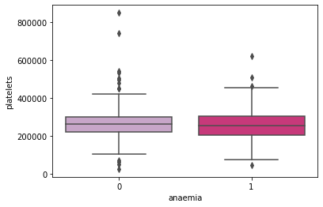
Outlier

Slide 11
Result
Model | Accuracy | Precision | Recall | F1-score
Logistic Regression | 90% | 0 → 0.88 1 → 0.95 | 0 → 0.79 1 → 0.78 | 0 → 0.92 1 → 0.86
Decision Tree | 81.67% | 0 →0.84 1 →0.77 | 0 →0.86 1 →0.74 | 0 →0.85 1 →0.76
Support Vector Machine | 80% | 0 →0.78 1 →0.87 | 0 →0.95 1 →0.57 | 0 →0.85 1 →0.67
Random Forest | 86.67% | 0 →0.84 1 →0.94 | 0 →0.97 1 →0.70 | 0 →0.90 1 →0.80

Slide 12
Result
Model | Accuracy | Precision | Recall | F1-score
Boosting | 88.33% | 0 → 0.89 1 → 0.86 | 0 → 0.92 1 → 0.83 | 0 → 0.91 1 → 0.84
Stacking | 85% | 0 →0.87 1 →0.82 | 0 →0.89 1 →0.78 | 0 →0.88 1 →0.80
Bagging (base estimator : decision tree classifier) | 80% | 0 →0.82 1 →0.76 | 0 →0.86 1 →0.70 | 0 →0.84 1 →0.73
Bagging (base estimator : Random forest classifier) | 88.33% | 0 →0.86 1 →0.94 | 0 →0.97 1 →0.74 | 0 →0.91 1 →0.83

Slide 13
Thank you

